Slide 1
Networks R Us Networking Technologies November 2015 by Simon Light

Slide 2
Contents
Network Technologies (P1)
Operating systems
Protocols
Network Layout
Network Devices
Networking Tools
fault management
performance management
using system software to find network assets.
Examples
Emerging network technologies
Advances in robotics
Integrated systems
Global data centre management
Notes:
femerging network technologies, in specific, advances in robotics, integrated systems and global data centre management.

Slide 3
Network Technologies
Notes:
OK so I'm going to start with network technologies.

Slide 4
Operating systems
The role of the operating system is to mange both software and let them work together.
It provides services to a range of devices such as:
Firewalls
Peripherals
Audio jack and speaker capability
Popular OS’s:
Windows(7,8,10)
OS X
Linux(Ubuntu, Mint, Debian)
Android(lollypop, marshmallow, ice-cream sandwich)
Servers (Ubuntu server, Windows Home Server/Business server)

Slide 5
Operating systems
Windows
Windows will be the most common OS to you whether that is 7,8, or most recent, 10. It has a very easy to use UI and is popular across the world.
It is closed source which means only the developers have access to the source code. This means there are fewer distro’s of Windows but they are all complete and finished which is not true of open source OS’s.
Linux
Linux is the most popular free open source OS. It has many distro’s over a wide range from daily use to server management and pen testing#
Linux also supports a wide range of software and devices which is both beneficial(as there is an application for everything) and bad (as not all applications are professionally made and working to the standard they should.

Slide 6
Network Protocols

Slide 7
Network Protocols
Protocols allow communication between devices on a network.
Some examples of protocols are:
CSMA/CD
Local Talk
Token Ring
FDDI
ATM
HTTP/HTTPS
NTP
SMTP
ICMP
SNMPv3

Slide 8
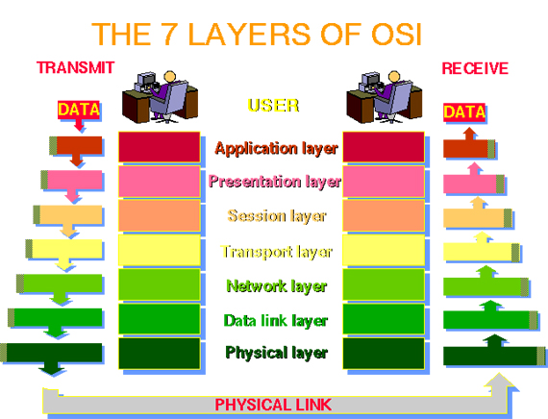
Network Protocols

Slide 9
Network Protocols : SNMPv3
SNMP stands for Simple Network Management Protocol
SNMPv3 is the third version of SNMP.
It includes added security by encrypting data that is transmitted.
SNMP is used for controlling routers and other network devices. It can be used to set up alerts about your network and recorded data such as bandwidth usage.

Slide 10
Network Protocols : HTTP
HTTP stands for Hypertext Transfer Protocol.
It is most commonly used for transferring data over the worldwide web.
HTTP is a 7th layer protocol which means that it runs from an application level.
HTTPS is exactly the same as HTTP except HTTPS contains encryption to avoid the loss of data.

Slide 11
Network Protocols : NTP
NTP stands for network time protocol.
It is used to synchronise the time set on devices across a network.
It uses the time zone of UTC and be as accurate as a fraction of a millisecond.
NTP is needed for security purpose and so that you can access machines remotely.

Slide 12
Network Protocols : SMTP
SMTP stands for Simple Mali Transfer Protocol
It is used to transfer emails including the text, formatting and attachments.
Recently SMTP is only used for sending data to a relay server and not receiving mail (this is done with either POP3 or IMAP)

Slide 13
Network Layouts

Slide 14
Network Layouts
There are two main types of network layouts:
Physical (Wired)
Logical (Wireless)
Wireless networks are used because:
Can be used on the moved/not in fixed position.
Doesn't require as much cabling and trunking.
Almost all devices can support wireless data of some kind.
Wired networks are used because:
They can achieve higher connection speeds.
They are more secure as the user has to be in the building to access the data.

Slide 15
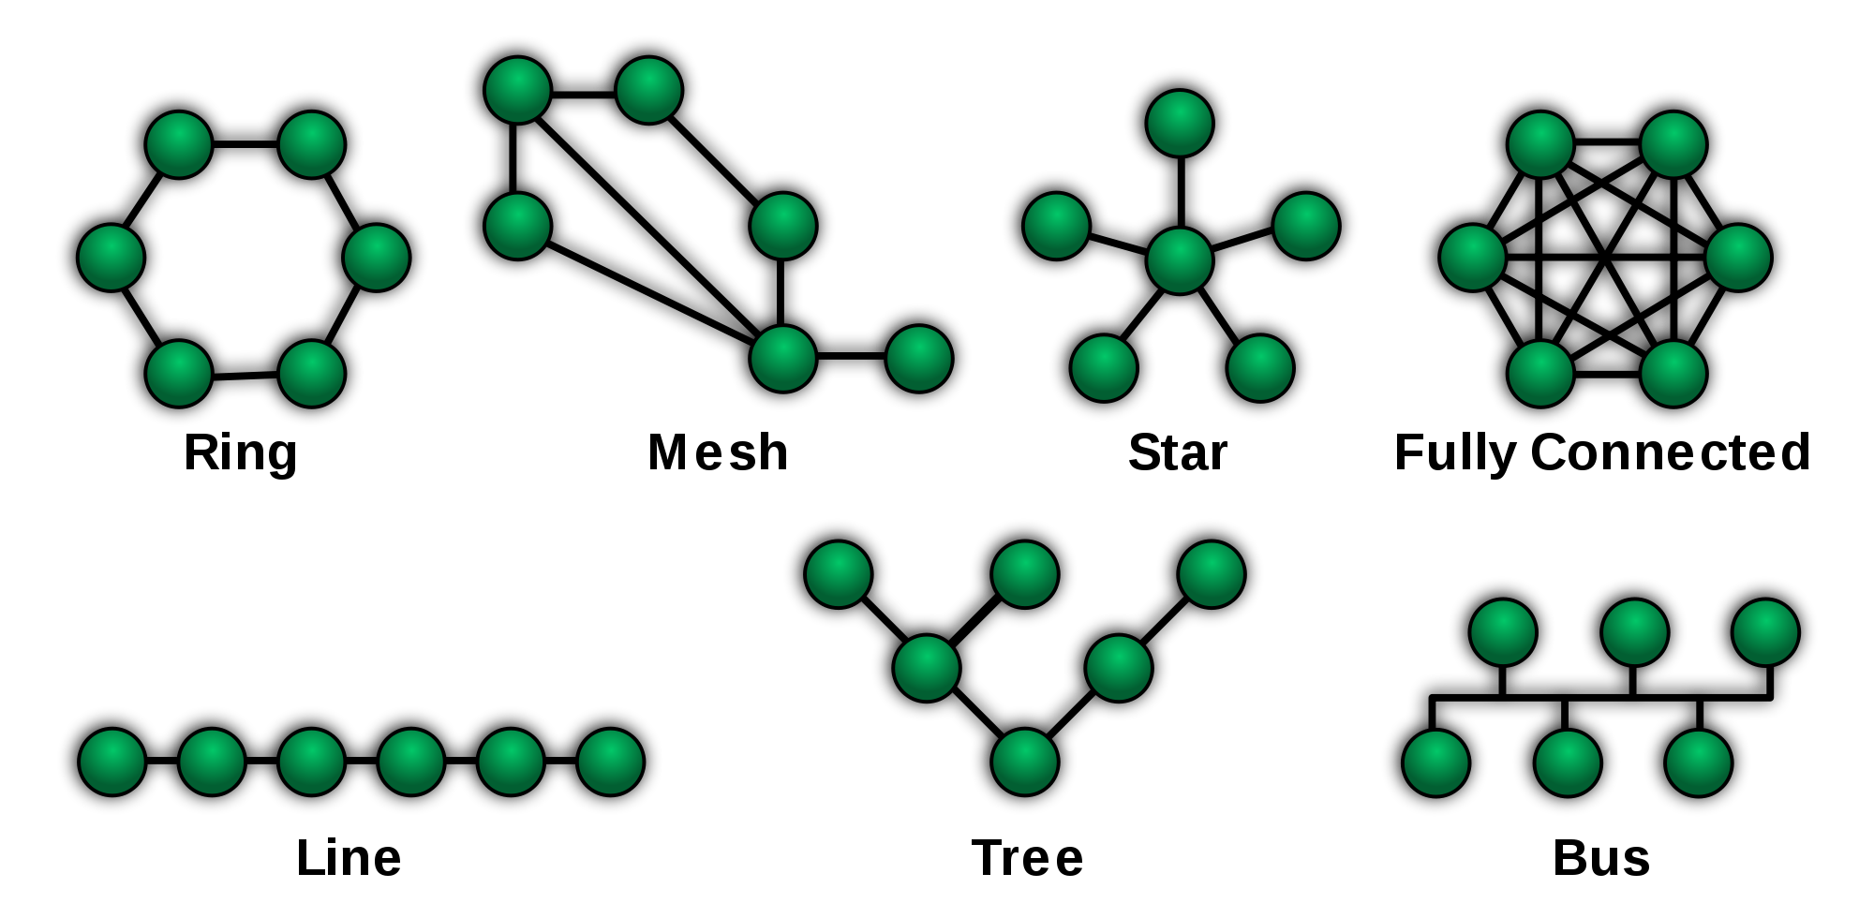
Network Layouts : Star
The star allows for users to connect through one server.
This is useful for network management/monitoring

Slide 16
Network Layouts : Ring
There is no need for a server in this setup.
This allows for fast connections with no venerable points.

Slide 17
Network Layouts : Mesh
Mesh is where each node acts as a relay.
This allows for data to be passed through nodes limiting network setup.
This is useful for ad-hoc servers

Slide 18
Network Layouts : Fully Connected
Fully connected allows for all nodes to be connected directly
This allows for high speed but also high start-up/connections

Slide 19
Network Layouts : Line
The line allows for the most minimal setup.
It is limited on security as the 1st node has to pass data through all of the nodes to get to the last node.

Slide 20
Network Layouts : Tree
Bus allows for the centre line to be very powerful with smaller lines coming off.

Slide 21
Network Devices

Slide 22
Network Devices
Network devices are devices that are used on a network.
Some examples of these are:
Servers
Routers
Switches
Interface card
Workstation

Slide 23
Network Devices : Servers
Servers are used to control and maintain the network.
Servers are just PC’s that have been configured in a specific way. They are also of quite a high specification.
They can be used as:
File servers
Mail Servers
Proxys
Web Servers

Slide 24
Network Devices : Workstations
Workstations are PC’s that are used for a specific job e.g. CAD, rendering etc.
The two main types of workstation are :
Thick Client – OS and applications
Thin Client – Little OS and no/few applications

Slide 25
Network Devices : Interface Cards
Connects a device to a wired internet connection
Can use a radio interface for wireless connection
Can be a plug in card or just a separate device
Uses a unique mac adress

Slide 26
Networking Tools

Slide 27
Networking Tools
Network Tools assist the management and maintenance of a network.
There are three main types:
Fault Management
Performance Management
Detection of Network Assets

Slide 28
Network Tools : Fault Management
Software or functions that detect errors or malfunctions in a network
Maintain error logs
Adjust for changes in environment that may alter the speed or reliability of a network
Notify administrators when errors appear that require further repair than the system can provide
May be active or Passive

Slide 29
Network Tools : Fault Management
A fault management system detects and handles faults in a network. These systems also adjust for changes in a networks environment, scan for threats such as viruses, and alert administrators of errors.
Fault management systems can be any tools or specific procedures for detecting and managing errors.
A fault management system may also maintain and store error logs.
Fault detection systems may be active or passive.
A passive system requires individual devices to transmit error messages or alarms when they detect their own errors. While this mode allows for a simpler method of monitoring, where a system just waits to receive error messages, if a device loses the ability to transmit an alarm then the Fault Management system will not become aware of the error, and will not alert an administrator.
An active system will periodically ping all of the devices it knows about, checking whether they are online and functioning correctly. If a pinged device does not respond then the system will sound an alarm and alert an administrator

Slide 30
Network Tools : Performance Management
Performance Management systems monitor a network and adjust for changing conditions that affect the speed of the network.
Analyze and record performance.
Help diagnose causes of slowdown in networks.

Slide 31
Network Tools : Performance Management
Performance management systems consist of software or procedures which monitor networks for changes in speed and efficiency of a network. They also adjust networks so that the networks function optimally.
Performance management systems also monitor, analyze and store performance and performance records.
Performance management systems can be used help diagnose causes of slowdown within a network.

Slide 32
Network tools : Detection of network assets
This basically just finds assets connected to the network.
This can go as far as:
Finding model/types/specs of the device
Using agents to display what software is installed on the device

Slide 33
Networking Tools : Examples
Wireshark
PsPing
CiscoWorks
Whois

Slide 34
Networking Tools : Wireshark
“Wireshark is the world's foremost network protocol analyser. It lets you see what's happening on your network at a microscopic level. It is the de facto (and often de jure) standard across many industries and educational institutions”.
Wireshark displays traffic that has come through a wired connection. It then displays this information that can be filtered and analysed by the user.
It is useful for checking that the network hasn't got any unwanted traffic.

Slide 35
Networking Tools : PsPing
PsPing measures and monitors the levels of bandwidth, latency and ultimately ping between network devices.
It can also be used to display this information and show which addresses are the biggest and smallest users.
This is good for diagnosing slow areas in the network and improving them.

Slide 36
Networking Tools : CiscoWorks
CiscoWorks can be used to aid the process of administration , configuration, monitoring and general troubleshooting of Cisco based networks.
Examples of this include:
Increased accuracy and efficiency of network maintenance staff.
Quickly identifying possible problems within the network and providing fixes and configuration suggestions to prevent such problems.
Increasing the security of the network by displaying possible entry points.

Slide 37
Networking Tools : Whois
Whois tells the user information about the address it has entered.
The address can either be as an ip (66.193.254.46) or a DNS name (www.sysinternals.com).
It can display information such as : who the device is registered to, where the device is, its ip etc.

Slide 38
Emerging Technologies

Slide 39

Machine learning

Slide 40
Machine learning
Machine Learning is a field of Mathematics and Computer Science that specializes in computer programs can ‘learn’ off of experiences and outcomes.
Machine Learning can have a huge impact on networking. With the addition of machine learning technologies, networks become much more adaptable and resilient. This means that in the future, a network could find mistakes in a network and fix itself/redirect the stream to fix the problem, very similar to the human brain.
As machine learning systems require data to train on, it can take a while before a learning network can correctly optimize, however when it does results can surpass those of algorithmic optimization.

Slide 41
How it can affect a network
Machine learning can affect a network in many ways.
Network devices can change there states depending on how the network is being used. This means that the network will always be the most effective for the job in hand rather than just for one purpose. This could be done from changing the packet switching methods in a switch to the topology of the network.
This method could also be used for unresponsive nodes. If one node drops frequently under load, a machine learning algorithm could be used and it would try to send less traffic through those nodes. This would then increase the reliability of the network.

Slide 42

Quantum Computing

Slide 43
Quantum Computing
Research on quantum computing first began in the 1980s and while research still continues, quantum computing is still in its infancy.
D-Wave Systems Inc. demonstrated the Orion system, a prototype quantum computer, in 2007. Since then they have developed and released the D-Wave One, a business and research grade computer platform.
Quantum Computing could have a huge impact on networking, requiring new techniques to be employed by network designers to handle the large amount of information processed. While a quantum computer could communicate using a regular network, they can also communicate using quantum networks.
Quantum networks are concept for a network where the data exchanged stays in a quantum state, generally using fiber optic cables to send photons in different quantum states. This method allows for quantum computers to communicate in a more natural way. This would require new training and protocols in order to formalize quantum network standards.

Slide 44
How it can affect a network
Quantum computing is coming soon and I going to be very powerful in networks.
Due to the way that quantum computing works, they cannot be integrated into todays networks. This means there will need to be a new standard for networking.
This new standard would probably use protons to share information along fibre optic style cables. This would carry lots more information in one pulse and the pulses would travel a lot faster.

Slide 45
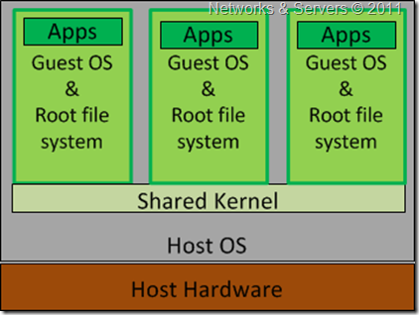
Containers and OS level Virtualization

Slide 46
Containers and OS level Virtualization
OS Level Virtualization was originally implemented in 1982 with unix’s chroot program. While without the plentiful features of current offerings, chroot was still powerful, and influenced containerization in the times to come. Nowadays docker dominates the containerization market, although it uses Linux Containers as a backend, a feature available since 2008.
In Linux, OS level virtualization a single kernel instance runs, with multiple so called ‘User Spaces’ on top. This means that no virtualization in the regular sense is ever used, as the hardware is just shared rather than simulated. Containers allow for increased security, as even with hundreds of instances on top of a kernel, no instance is able to interact with another, or even aware of other instances. Containers also allow limiting resource use on a per instance basis, limiting CPU time or RAM usage
Containers change networking massively. While new features such as compartmentalization of networking components like server processes changes the way security is handled, new problems are also faced. With what was once a single machine now making drastically more network requests, infrastructure may need to be redesigned

Slide 47
How it can affect a network
Containers are the new alternative to virtualization.
In the near future, you will be able to set up a computer with all of the popular OS’s running at the same time.
This will be great for SSH networks as users who develop for OS’s can SSH into any OS possible
For Example: if a developer is making a tool for Ubuntu, he can sit at home and SSH into an Ubuntu OS on a network without having to install the OS on his machine. This saves time, space and computational resources.

Slide 48
Bibliography
http://www.informationweek.com/cloud/10-emerging-it-trends-from-gartner-symposium/d/d-id/1322569?_mc=RSS_IWK_EDT&image_number=9
https://www.edrawsoft.com/Network-Protocol.php
http://homepages.uel.ac.uk/u0415051/OSI%20MODEL/
http://www.cisco.com/c/en/us/td/docs/ios-xml/ios/snmp/configuration/xe-3se/3850/snmp-xe-3se-3850-book/nm-snmp-snmpv3.html
http://www.networkmanagementsoftware.com/snmp-tutorial
https://en.wikipedia.org/wiki/Hypertext_Transfer_Protocol
http://searchnetworking.techtarget.com/definition/Network-Time-Protocol
https://en.wikipedia.org/wiki/Simple_Mail_Transfer_Protocol
https://en.wikipedia.org/wiki/Network_topology
https://www.wireshark.org/
https://technet.microsoft.com/en-us/sysinternals/psping.aspx

